Slide 1
Chapter 7 Discrete Probability
Section 1
An Introduction to Discrete Probability

Slide 2
Outline
Introduction
Finite Probability
The Probability of Combinations of Events
Probabilistic Reasoning - Examples

Slide 3
Introduction
Why Probability?
  In the real world, we often do not know whether a given proposition is true or false.
  Probability theory gives us a way to reason about propositions whose truth is uncertain.
  It is useful in weighting evidence, diagnosing problems, and analyzing situations whose exact details are unknown.

Slide 4
Introduction
Experiment (试验)
  An experiment is a procedure that yields one of a given set of possible outcomes
  Rolling a die (掷骰子), for example
Sample space (样本空间)
  The set of possible outcomes
  For a die, that would be values 1 to 6
Event (事件)
  An event is a subset of the sample space
  If you rolled a 4 on the die, the event is the 4

Slide 5
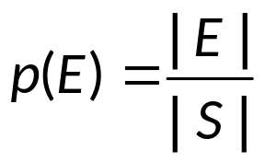
Finite Probability
Definition
  The probability of an event E is
  where S is the finite sample space
  Note that 0 ≤|E|≤ |S|, Thus, the probability will always between 0 and 1
  An event that will never happen has probability 0
  An event that will always happen has probability 1
  Originated from Laplace: The probability of an event with finitely many possible outcomes.

Slide 6
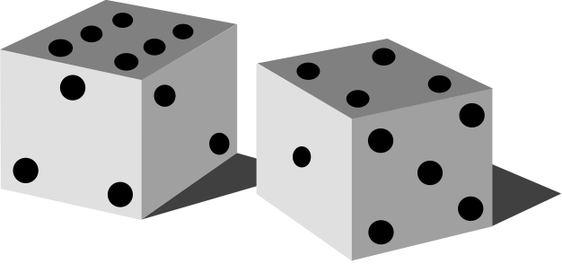
Finite Probability
Example.
  Suppose two dice are rolled. The sample space would be
 | 1 | 2 | 3 | 4 | 5 | 6
1 | × | × | × | × | × | ×
2 | × | × | × | × | × | ×
3 | × | × | × | × | × | ×
4 | × | × | × | × | × | ×
5 | × | × | × | × | × | ×
6 | × | × | × | × | × | ×
  and |S| = 36

Slide 7
Finite Probability
Example.
  The probability of “sum is 11”
 | 1 | 2 | 3 | 4 | 5 | 6
1 | × | × | × | × | × | ×
2 | × | × | × | × | × | ×
3 | × | × | × | × | × | ×
4 | × | × | × | × | × | ×
5 | × | × | × | × | × | ×
6 | × | × | × | × | × | ×
  Solution
  |E|=2, |S|=36
  Thus p|E|=|E|/|S|=2/36

Slide 8
Finite Probability
Example.
  The probability of getting “snake-eyes” (two 1’s)
  Solution
    Probability of getting a 1 on a 6-sided die is 1/6
    Via product rule, probability of getting two 1’s is the probability of getting a 1 AND the probability of getting a second 1
    Thus, it’s 1/6 * 1/6 = 1/36
Example.
  The probability of getting a 7
  Solution
    There are six combinations that can yield 7: (1,6), (2,5), (3,4), (4,3), (5,2), (6,1)
    Thus, |E| = 6, |S| = 36, p(E) = 6/36 = 1/6

Slide 9
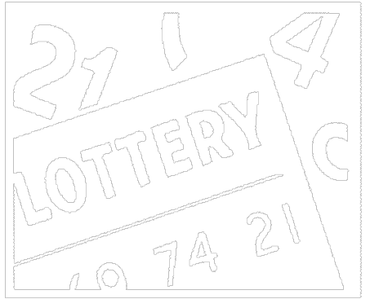
Finite Probability
Example.
  Suppose a lottery randomly selects 6 numbers from 40. What is the probability that you selected the correct six numbers? Order is not important.
  Solution
  |E| = 1, |S| = C(40,6),
  p(E) = 1/C(40,6) = 1/3,838,380 = 2.6×10⁻⁷

Slide 10
Combinations of Events
Theorem.
  Let E be an event in a sample space S. The probability of the event ∼E, the complementary event of E, is given by p(∼E) = 1 - p(E)
Theorem.
  Let E₁ and E₂ be events in the sample space S. Then p(E₁∪E₂) = p(E₁)+ p(E₂)- p(E₁∩E₂)

Slide 11
Combinations of Events
Example.
  Suppose a red die and a blue die are rolled. The sample space would be
 | 1 | 2 | 3 | 4 | 5 | 6
1 | × | × | × | × | × | ×
2 | × | × | × | × | × | ×
3 | × | × | × | × | × | ×
4 | × | × | × | × | × | ×
5 | × | × | × | × | × | ×
6 | × | × | × | × | × | ×
  and |S| = 36
  What’s the probability of “sum is 7 or blue die is 3”?

Slide 12
Combinations of Events
  Solution
  Let E₁ = “Sum is 7”
  E₂ = “Blue die is 3”
  Then
  |E₁| = 6
  |E₂| = 6
  |E₁∩E₂| = 1
  Thus
  p(E₁∪E₂) = p(E₁)+ p(E₂)- p(E₁∩E₂)
  = 6/36+6/36-1/36
  = 11/36
 | 1 | 2 | 3 | 4 | 5 | 6
1 | × | × | × | × | × | ×
2 | × | × | × | × | × | ×
3 | × | × | × | × | × | ×
4 | × | × | × | × | × | ×
5 | × | × | × | × | × | ×
6 | × | × | × | × | × | ×

Slide 13
Combinations of Events
Example.
  Choose a number n between 1 and 100, what is the probability that n is divisible by 2 or 5 or both?
  Solution
    p(2|n) = 50/100 (all the even numbers)
    p(5|n) = 20/100
    p(2|n) and p(5|n) = p(10|n) = 10/100
    p(2|n) or p(5|n) = p(2|n) + p(5|n) - p(10|n)
    = 50/100 + 20/100 - 10/100
    = 3/5

Slide 14
When is gambling worth it
Example
  What if you gamble $1, and have a ½ probability to win $10?
  Solution.
  If you play 100 times, you will win (on average) 50 of those times
    Each play costs $1, each win yields $10
    For $100 spent, you win (on average) $500
  Average win is $5 (or $10 * ½) per play for every $1 spent

Slide 15
When is gambling worth it
Example
  What if you gamble $1 and have a 1/100 probability to win $10?
  Solution.
  If you play 100 times, you will win (on average) 1 of those times
    Each play costs $1, each win yields $10
    For $100 spent, you win (on average) $10
  Average win is $0.10 (or $10 * 1/100) for every $1 spent
One way to determine if gambling is worth it:
  probability of winning * payout ≥ amount spent
  Or p(winning) * payout ≥ investment
  Of course, this is a statistical measure

Slide 16
When is lotto worth it
Example
  Many lotto games you have to choose 6 numbers from 1 to 48
  Total possible choices is C(48,6) = 12,271,512
  Total possible winning numbers is C(6,6) = 1
  Probability of winning is 0.0000000814, or 1 in 12.3 million
  If you invest $1 per ticket, it is only statistically worth it if the payout is > $12.3 million
  As, on the “average” you will only make money that way
  Of course, “average” will require trillions of lotto plays…

Slide 17
Probability of multiple events
Example
  Assume you have a 5/6 chance for an event to happen (e.g., rolling a 1-5 on a die). What’s the chance of that event happening at least once in two experiments?
  Cases:
    Event happening neither time: 1/6 * 1/6 = 1/36
    Event happening first time: 5/6 * 1/6 = 5/36
    Event happening second time: 1/6 * 5/6 = 5/36
    Event happening both times: 5/6 * 5/6 = 25/36
  It’s (5+5+25)/36 = 35/36
  Or 1-1/36 = 35/36

Slide 18
Probability vs. odds
Remark
  Chance can be expressed either as a probability or as odds. In most contexts, there is no particular reason to prefer one over the other. Most scientists tend to feel more comfortable thinking about probabilities than odds, but that is a matter of training and custom, not logic.
    The probability that an event will occur is the fraction of times you expect to see that event in many trials. Probabilities always range between 0 and 1.
    The odds are defined as the probability that the event will occur divided by the probability that the event will not occur.

Slide 19
Probability vs. odds
Remark
  A probability of 0 is the same as odds of 0. Probabilities between 0 and 0.5 equal odds less than 1.0. A probability of 0.5 is the same as odds of 1.0. Think of it this way: The probability of flipping a coin to heads is 50%. The odds are “fifty: fifty,” which equals 1.0.
  As the probability goes up from 0.5 to 1.0, the odds increase from 1.0 to approach infinity. For example, if the probability is 0.75, then the odds are 75:25, three to one, or 3.0.
  If the odds are high (million to one), the probability is almost 1.00. If the odds are tiny (one to a million), the probability is tiny, almost zero.

Slide 20
Probability vs. odds
Remark
  If there is a probability of something happening, then the odds can be considered the number of successes you expect to get for every failure on average. High odds correspond to high probabilities, low odds to low probabilities.
  To calculate the odds:
  O = p/(1-p)
  To go from odds back to probabilities:
  p = O/(1+O)
  While probabilities are bound to [0,1], odds are bound to [0, )

Slide 21
Monty Hall Paradox
The Monty Hall problem paradox
  Consider a game show where a prize (a car) is behind one of three doors
  The other two doors do not have prizes (goats instead)
  After you picking one of the doors (keeping closing), the host (Monty Hall) opens a different door to show you that the door he opened is not the prize
  You can change your choice now? Do you?
  Answer.
  Your initial probability to win (i.e. pick the right door) is 1/3
  After Monty opens a wrong door, if you change your choice, your chance of winning is 2/3 (shown in next page)
  Thus, your chance of winning doubles if you change

Slide 22
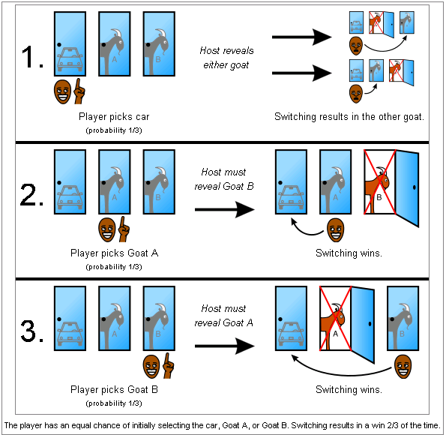
Monty Hall Paradox

Slide 23
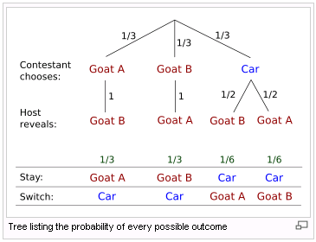
Monty Hall Paradox
  Decision Tree

Slide 24
Monty Hall Paradox
  In the first two cases, wherein the player has first chosen a goat, switching will yield the car.
  In the third and fourth cases, since the player has chosen the car initially, a switch will lead to a goat.
  The probability that switching wins is equal to the sum of the first two events: 1/3 + 1/3 =2/3.
  Likewise, the probability that staying wins is 1/6 + 1/6 =1/3.

Slide 25
Monty Hall Paradox
Exercises.
  Consider 100 doors. You choose one, and then Monty opens 98 wrong doors. Do you switch?
  Your initial chance of being right is 1/100
  Right before your switch, your chance of being right is still 1/100 just because you know more info about the other doors doesn’t change your chances. You didn’t know this info beforehand!
  Your final chance of being right is 99/100 if you switch
    Two choices for you: your original door and the new door. The original door still has 1/100 chance of being right. Thus, the new door has 99/100 chance of being right
    The 98 doors that were opened were not chosen at random! Monty Hall knows which door the car is behind

Slide 26
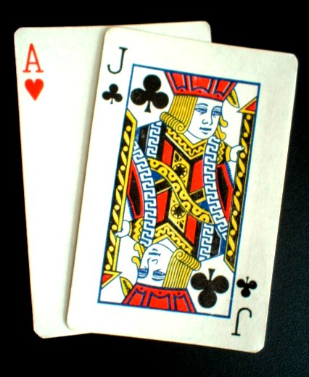
Blackjack
Rules of Blackjack game
  You are initially dealt two cards
    10, J, Q and K all count as 10 (called ten cards)
    Ace is EITHER 1 or 11 (player’s choice)
  You can opt to receive more cards (a “hit”)
  You want to get as close to 21 as you can
    If you go over, you lose (a “bust”)
  You play against the house
    If the house has a higher score than you, then you lose

Slide 27
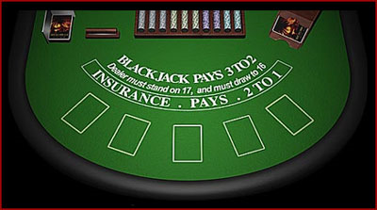
Blackjack
  Blackjack table

Slide 28
Blackjack
  Getting 21 on the first two cards is called a blackjack
    Or a “natural 21”
  Assume there is only 1 deck of cards
  Possible blackjack hands:
    First card is an A, second card is a 10, J, Q, or K
      4/52 for Ace, 16/51 for the ten card
      p₁ = (4/52)*(16/51) = 0.0241 (or about 1 in 41)
    First card is a 10, J, Q, or K; second card is an A
      16/52 for the ten card, 4/51 for Ace
      p₂ = (16/52)*(4/51) = 0.0241 (or about 1 in 41)
  Total chance of getting a blackjack is the sum
    p = p₁+ p₂ = 0.0483, or about 1 in 20.72

Slide 29
Blackjack
  Assume there is an infinite deck of cards
    So many that the probably of getting a given card is not affected by any cards on the table
  Possible blackjack hands:
    First card is an A, second card is a 10, J, Q, or K
      4/52 for Ace, 16/52 for second part
      p₁ = (4*16)/(52*52) = 0.0236 (or about 1 in 42)
    First card is a 10, J, Q, or K; second card is an A
      16/52 for first part, 4/52 for Ace
      p₂ = (16*4)/(52*52) = 0.0236 (or about 1 in 42)
    Total p = 0.0473, or about 1 in 21.13 (vs. 20.72)
  Most casinos use “shoes” of 6-8 decks for this reason. It slightly lowers the player’s chances of getting a blackjack, and prevents people from counting the cards…

Slide 30
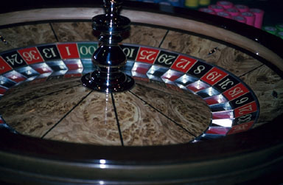
Roulette
What is a Roulette
  A wheel with 38 spots is spun
    Spots are numbered 1-36, 0, and 00
    European casinos don’t have the 00
  A ball drops into one of the 38 spots
  A bet is placed as to which spot(s) the ball will fall into
    Money is then paid out if the ball lands in the spot(s) you bet upon

Slide 31
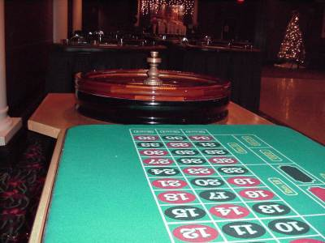
Roulette
  The roulette table

Slide 32
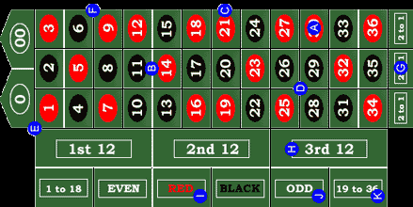
Roulette
  The roulette table

Slide 33
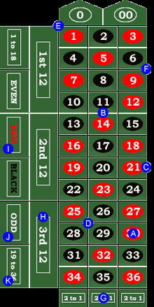
Roulette
Bets can be Probability Payout
placed on:
  A single number 1/38 36x
  Two numbers 2/38 18x
  Four numbers 4/38 9x
  All even numbers 18/38 2x
  All odd numbers 18/38 2x
  The first 18 nums 18/38 2x
  Red numbers 18/38 2x

Slide 34
Roulette
  It has been proven that no advantageous strategies exist, including:
    Learning the wheel’s biases
      Casino’s regularly balance their Roulette wheels
    Martingale betting strategy
      Where you double your bet each time (thus making up for all previous losses)
      It still won’t work!
      You can’t double your money forever
        It could easily take 50 times to achieve finally win
        If you start with $1, then you must put in $1*2⁵⁰ = $1,125,899,906,842,624 to win this way!
        That’s 1 quadrillion (K,M,G,T,Q)

Slide 35
Assignment
Exercises after 7.1: No.

